Slide 1
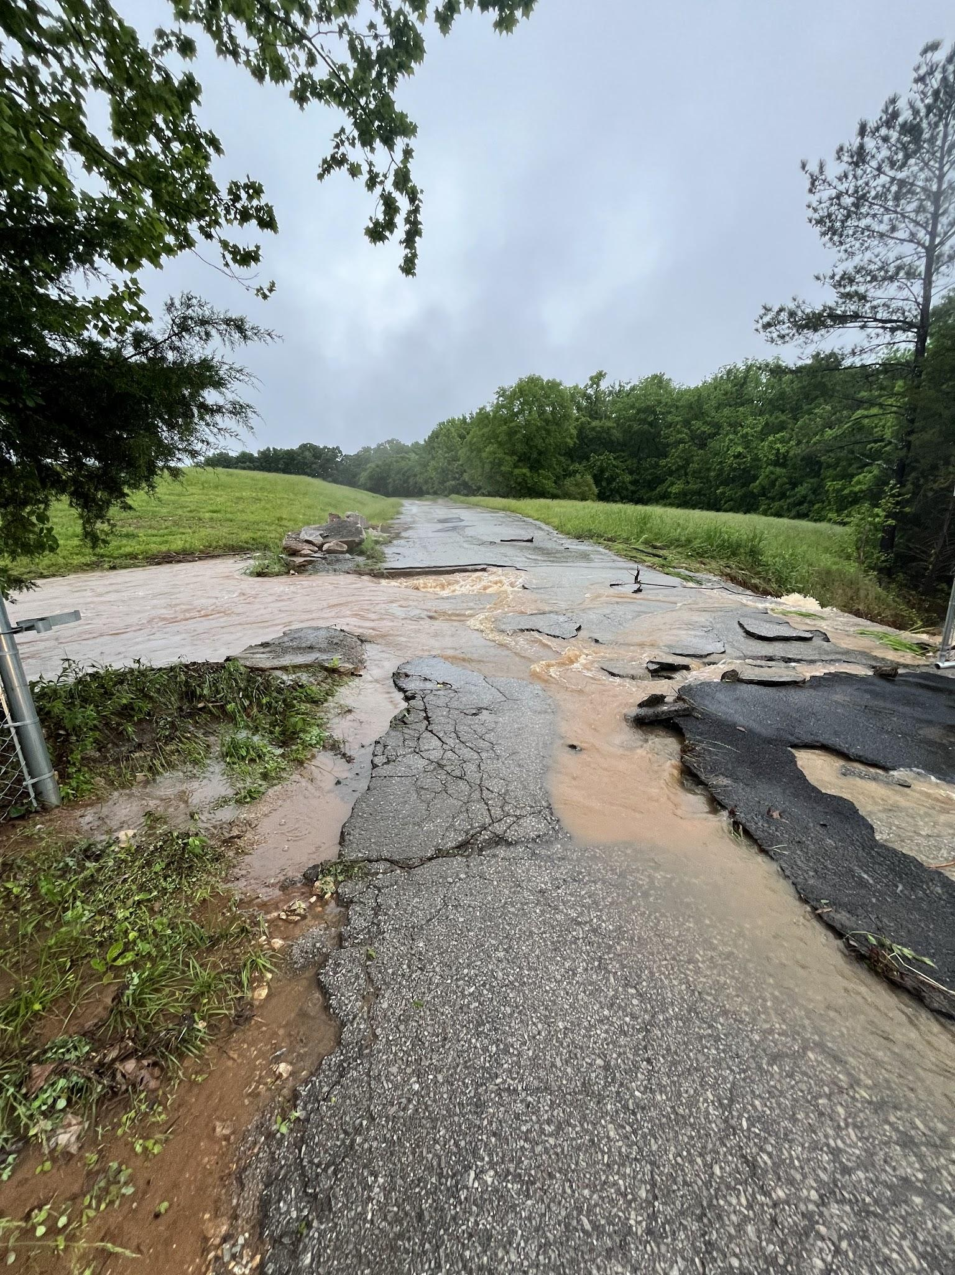
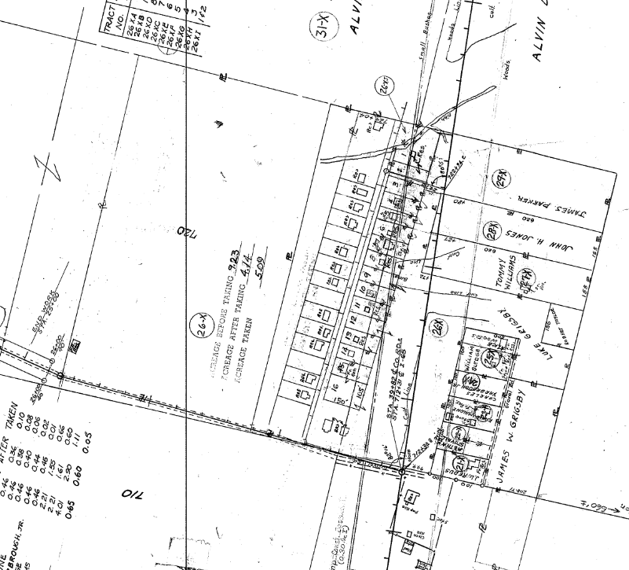
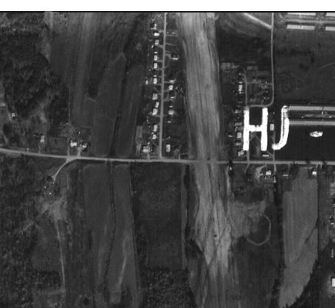
Capital Project:
Strain Road Community Drainage & Sewer
May 9, 2024
1964 I-65-3(37)
~1970

Slide 2

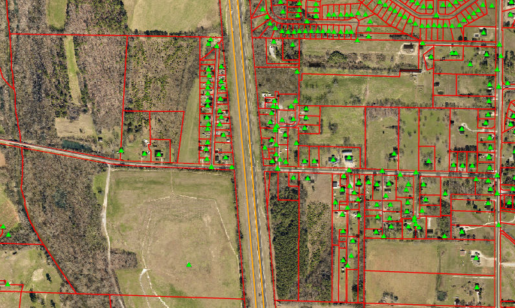
Overview
Project Status
City has requested preliminary design services with Krebs Engineering to develop plans under the SRF funds program to address deficient infrastructure in the area.
ADEM has committed assistance for preliminary design services.
Total scope of the project will include 4 phases of rehabilitation as a capital project in order of priority.
Project Limits
West Strain Rd
Lindsay Lane
I-65

Slide 3
Initial Drainage Project Goals
Scope Development & application to SRF
Preliminary design services and application to SRF for Phase I
Plan Set & Bids Phase II
Drainage projects on Strain West should be under construction at this point, and plans for Phase II drainage have been let.
Spring 2025
Fall 2025
Fall 2024
Summer 2025
Plan set & Bids Phase I
Focus on immediate drainage items on Strain Rd West basin. Begin Phase II preliminary design while Phase I under construction.
Assessment for Phase III & IV
Next step to scope Phase I & II improvements to local area drainage for scope development in final two phases.

Slide 4
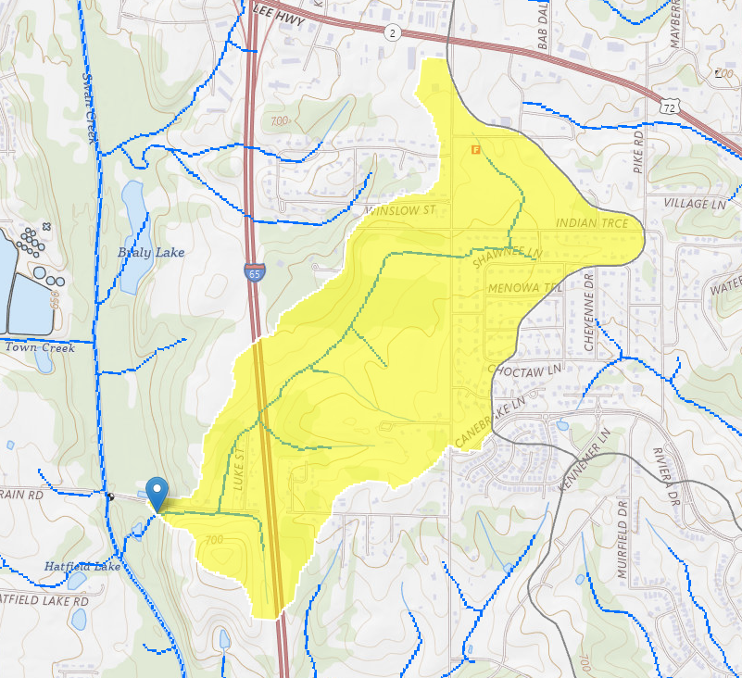
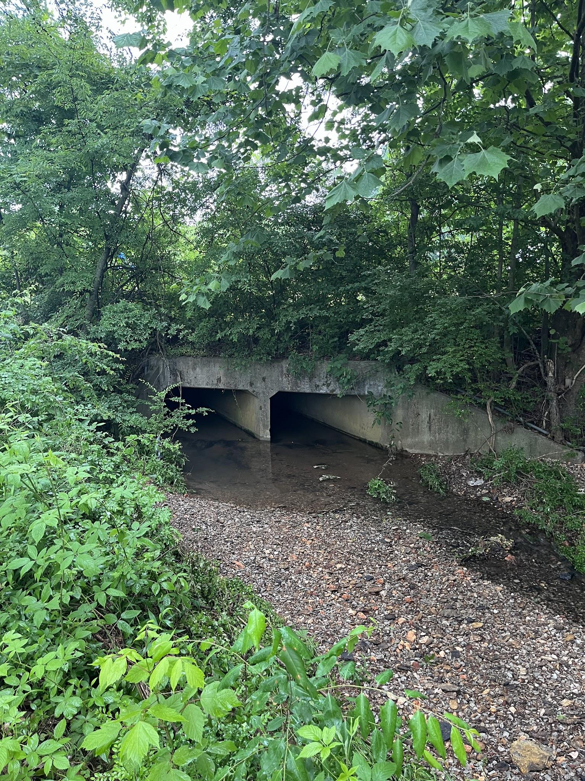
Strain Road Drainage Area
Drainage area includes 442 acres.
Estimated peak Urban runoff exceeds 1,020 cfs in a 100-year event.
Within the drainage basin the following neighborhoods have been developed over the past 10 years:
Natures Cove
Cambridge Townhomes
Steeplechase
New developments required to meet pre/post runoff, City required the installation of 7 detention facilities.
Existing drainage infrastructure West of I-65 was not sized for this basin.
Luke St, West of I-65 area was annexed 1973.
Strain Road East was annexed 1986.

Slide 5
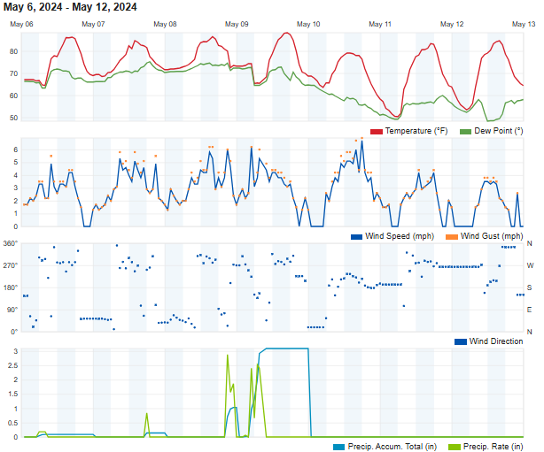
May 8-9th, 2024 Weather event
Destroyed access into the existing landfill at Strain Rd.
Overtopped roadways in multiple locations
Drainage area West of I-65 inundated due to lack of discharge and capacity.
Approximately 4.35 in. of precipitation within a 24-hour period occurred.
Most if not all rain fell within 4 hour period, and Tc of the basin is approximately 4.19 hours to discharge.

Slide 6
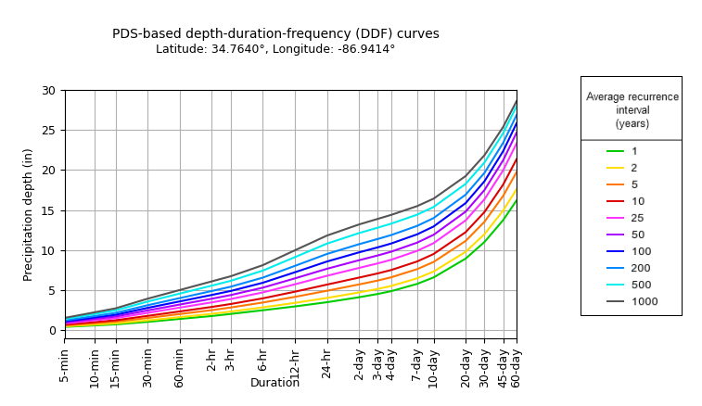
Event Return Interval
Based on latest NOAA Atlas 14 data, the event return interval most nearly matches a 25-year event or 4% storm.
Most if not all roadway pipes in basins are designed for 100-year event or 1% storms.
*Note*-reports ranged of 4”-6” of precipitation across the county during this event.

Slide 7
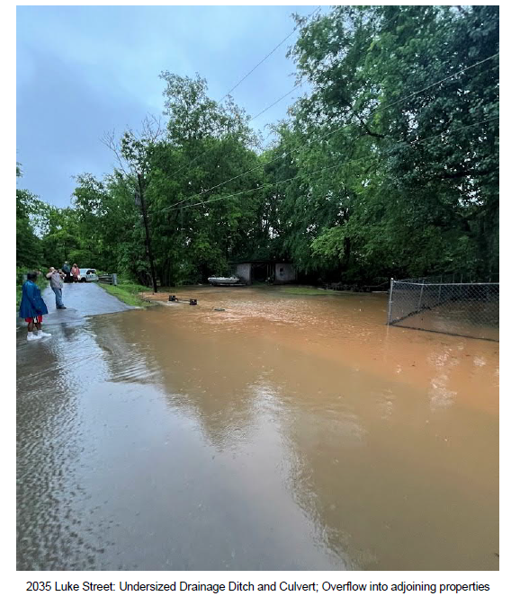
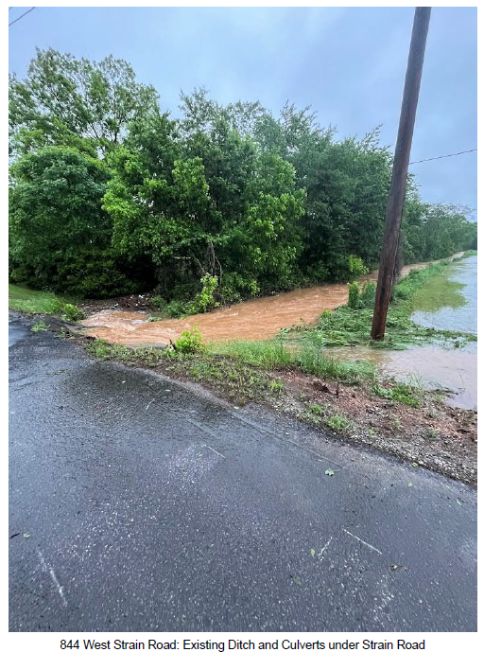
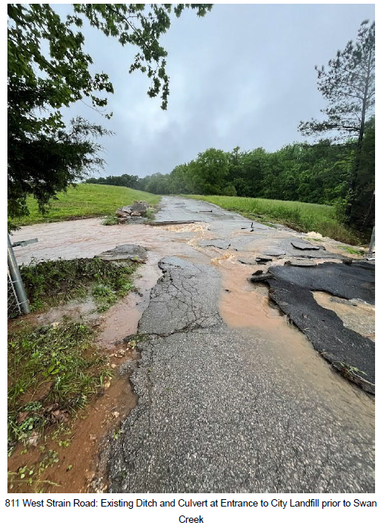
Phase I : Drainage West Strain Rd

Slide 8
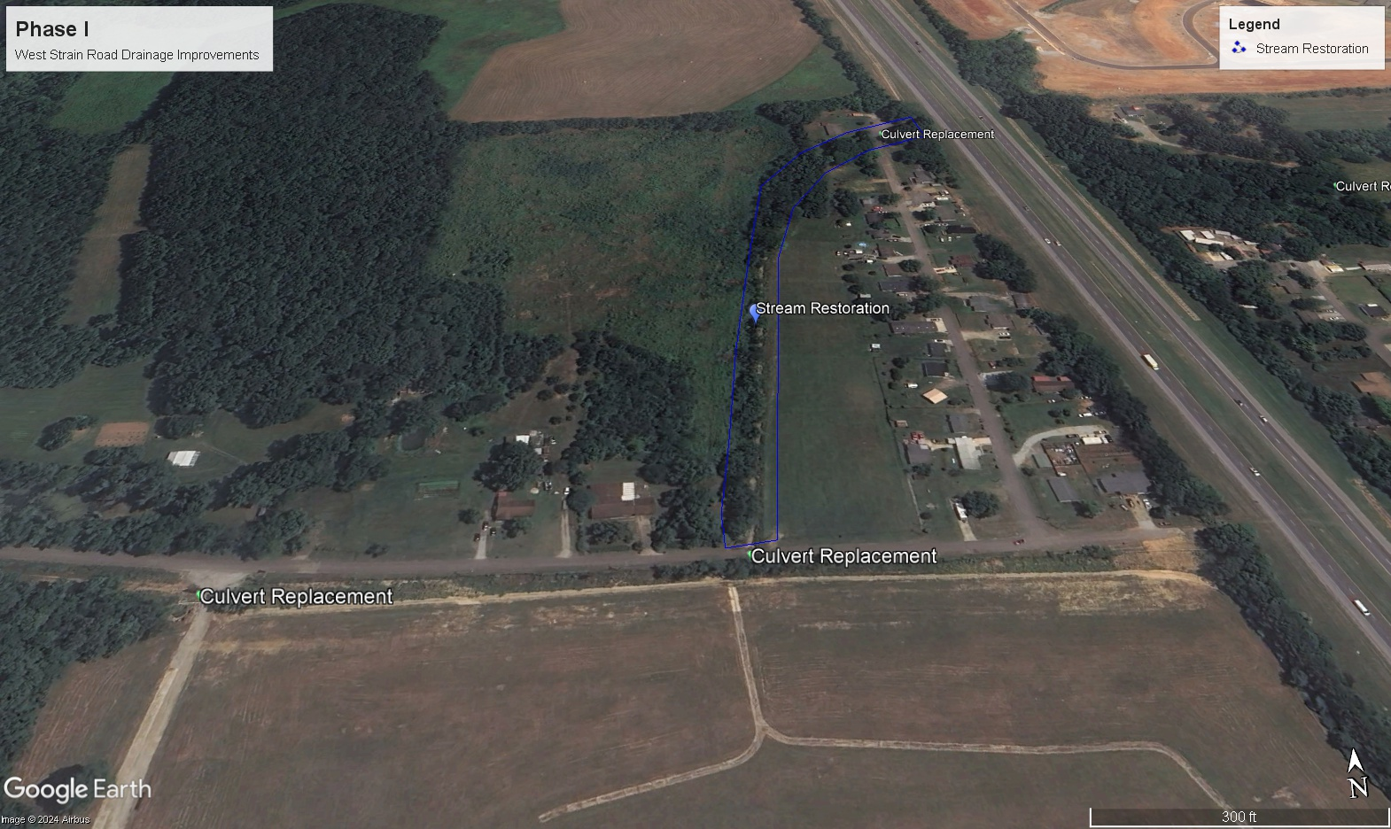
Phase I : Drainage West Strain Rd

Slide 9
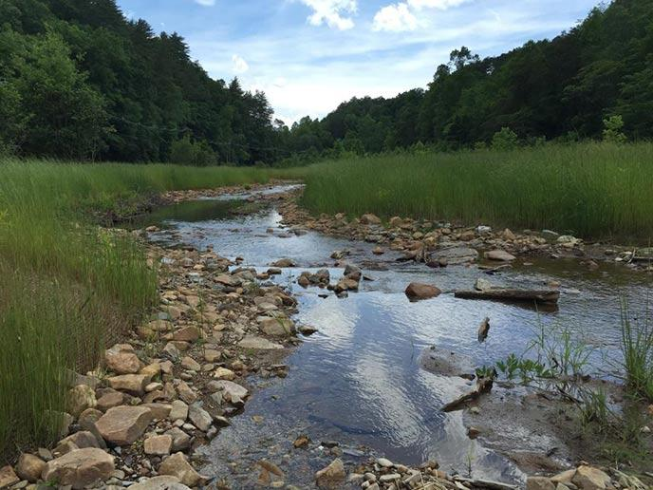
Phase I : Drainage West Strain Rd
Temporary measures are in place currently in failed areas.
Analyze and replace three “choke-point” culverts.
Acquire conservation easement, property, or drainage easement for area basin from I-65 to Strain Rd. Area is located on private property currently.
Streamline restoration, by enhancing cross section of channel.

Slide 10
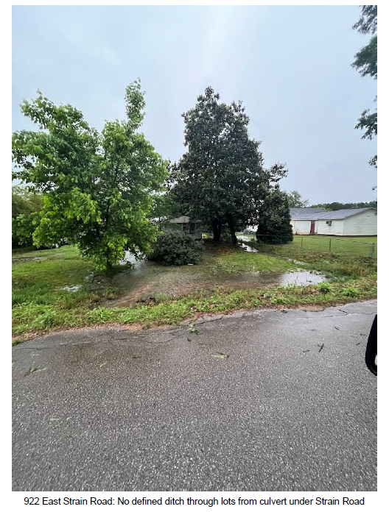
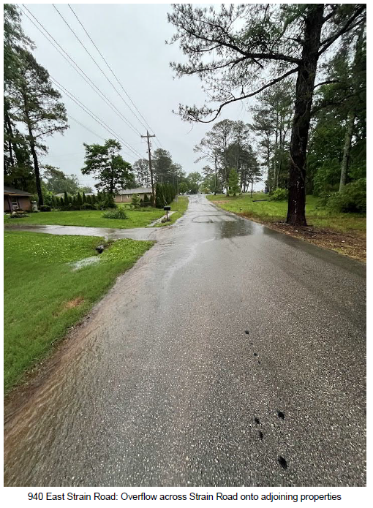
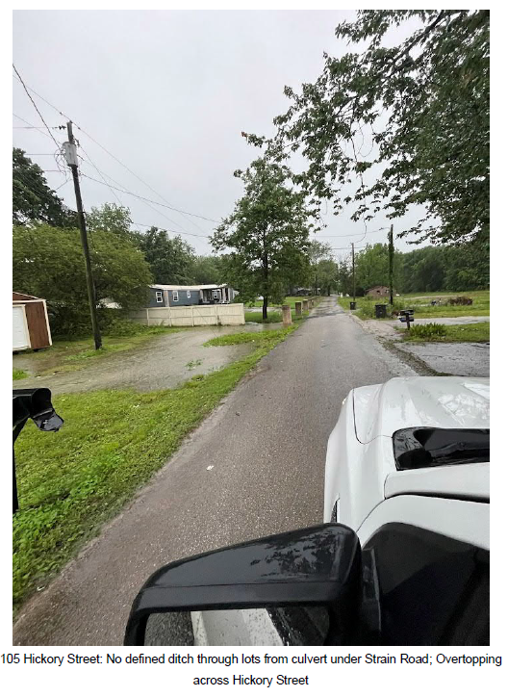
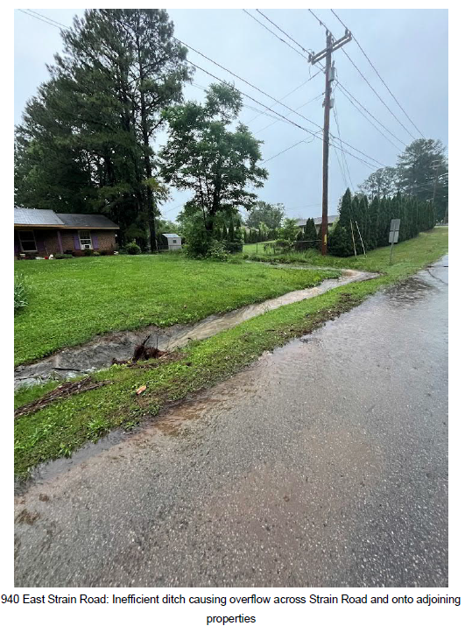
Phase II : Drainage East Strain Rd

Slide 11
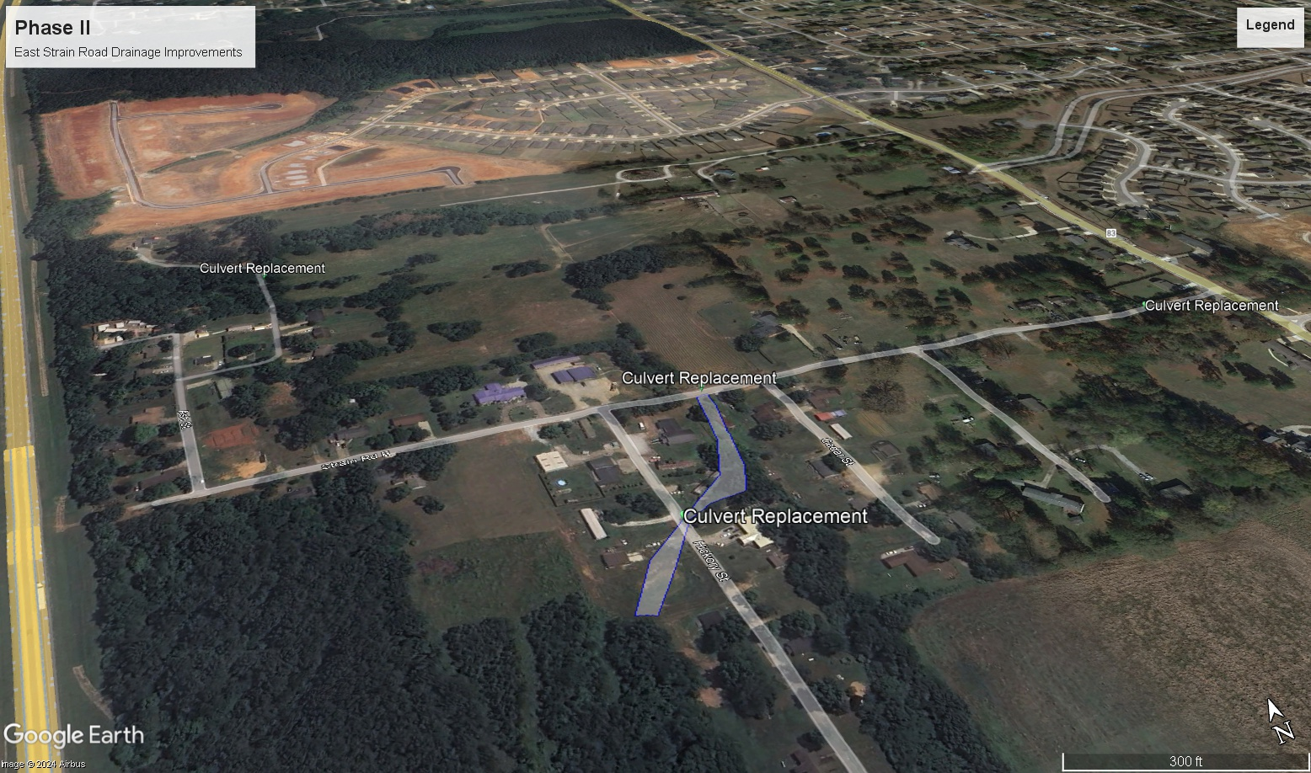
Phase II : Drainage East Strain Rd

Slide 12
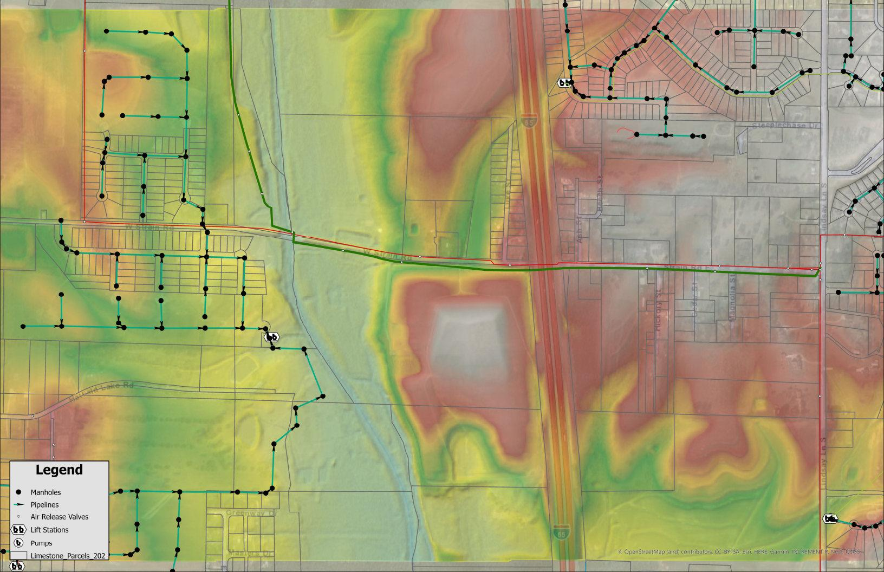
Sanitary Sewer Upgrades
Existing Conditions:
12” Force Main (Buc-ee’s)
24” Force Main (Canebrake)
110 Septic Systems
Luke St (25)
West Strain (4)
Beech St (9)
Ash St (16)
Magnolia St (12)
Cedar St (10)
East Strain (20)
Hickory St (14)

Slide 13
Summary
Project will be ongoing for FY 2025-2026.
Placing project into phases allows work to commence faster and tighten scope as some drainage issues that are corrected will improve existing drain field lines.

